Slide 1
Antidepressants
Biology/Psychology 3506

Slide 2
Introduction
Pretty obvious what they are for
But, what is depression?
Not just feeling down
More about flat affect
Lack of emotion
Seems to be more common now than ever

Slide 3
What is depression?
Basically major depressive disorder, and bipolar.
MDD
Low self esteem
Loss of interest
Pain
Bipoloar
Above plus mania
Irritable
‘pressure of speech’
‘invincible’ until challenged

Slide 4
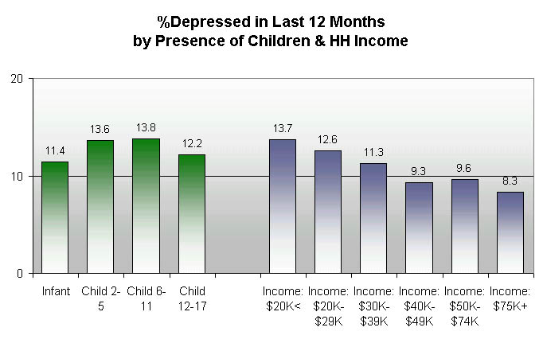

Slide 5
Introduction
Seems to be related to the monoamines
5 HT, NE and DA
5 HT especially
May not be the cause, but certainly plays a role
Seems all the drugs that work for depression do something at serotonin synapses

Slide 6
A teeny bit of history
MAOI were discovered by accident, well, their antidepressant qualities anyway
So were Tri cyclics
The new ‘second generation’ antidepressants
The SSRIs really
PROZAC!!!
SSNRIs
NRI
Lithium
Notes:
MAOI for TB, found anti depressant effects
RIMA Reversible inhibitors of MAO a
venlafaxine the first approved SSNRI 1993
NRIs, might not work……

Slide 7
Absorption
Similar for all three types
Most destroyed by first pass metabolism
One to three hours for peak blood concentration
Longer with SSRIs
Li is poison!!
Plus, a TI of like 3
careful

Slide 8
Distribution and excretion
Crosses all barriers
MAOI have short half life
TCA longer, almost 24 hr
SSRI 15 – 20 hr
Except fluoxetine
6 day half life
Norfluoxetine, 16 days!!!!!!!!!

Slide 9
Neurophysiology
MAOI obvious
TCA stop reuptake of monoamines
SSRI obvious
These effects are immediate, but the antidepressant effect is not, can take days or weeks even
Hmmmmmmmmm
How the hell does Li work?

Slide 10
Lithium
Some ideas include…..
Magic….
Seems to decrease NE release, increase 5Ht synthesis
Altering GABA
Attenuating Glutamate
Valproate works this way, so maybe….
Affecting NO signalling pathway

Slide 11
Remember
Super dangerous as noted
Elevated white blood cell count
Headaches
Confusion
Memory problems etc
.4 mmol/L concentration needed, about 1.2 can do you in, but, you might need this much for the mood stabilizing effects…..

Slide 12
Effects
ACh effects (MAOI, TCA)
Dry mouth
Constipation
Dizziness
Irregular heartbeat
Blurred vision
Ringing ears

Slide 13
Effects
SSRI
Nausea
Nervousness
Headache
Insomnia
‘Serotonin syndrome’
MAOI block MOA
Umm, you need that to digest certain things, so...
Notes:
Serotonin syndrome:Symptoms include high body temperature, agitation, increased reflexes, tremor, sweating, dilated pupils, and diarrhea. Body temperature increase
RIMA don’t have nearly the side effects of regular MAOI on tyramine metabolicm and hypertensive crisis.

Slide 14
Sleep effects
TCAs can actually be used as sleeping pills
Don’t overdo it…..
Some SSRIs affect REM, some do not
May actually be an antidepressant effect
Fluoxetine seems to make dreams more vivid.

Slide 15
More effects
No euphoria
No real ‘liking’
May be some cognitive effects, especially TCA
Personality cosmetic??

Slide 16
Tolerance and withdrawal
Both side effects and main effects show tolerance
Withdrawal can happen..
Agitation
Nervousness
Chills
Muscle aches
Easier to keep people on SSRIs

Slide 17
Bad Stuff
‘male sexual functioning’
Ahem
Seems that there are no effects on fetuses, but, nasty side effects in lab animals, so, if you are pregnant, you should probably lay off the antidepressants
OD

