Slide 1
Brains, Synapses and Neurotransmitters
Biology/Psychology 3506

Slide 2
Introduction
Well, the book is called Drugs and Behaviour, so, we had better know how the nervous system works
The nervous system is made up, basically, of two types of cells
Neurons
Do the communicating
Glial Cells
Support functions

Slide 3
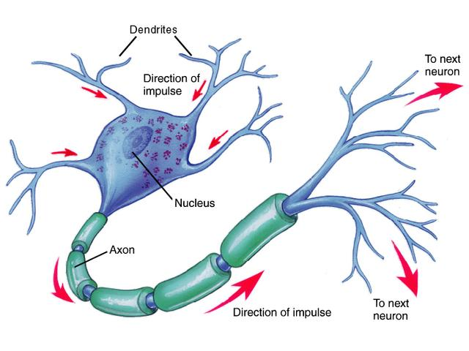

Slide 4
Some key neuron facts
One axon, many dendrites
Dendrite -> cell body -> axon
Axons transmit information
Dendrites receive information
Dendrites can grow and change
Make connections to more axons
Might be the basis of learning

Slide 5
Electrical activity of the neuron
Resting potential
About -70 mV
Selectively allowing certain ions in
With stimulation Na+ is allowed in
Action potential
Changes in one area lead to changes in another
Chemical to electrical, very cool

Slide 6
The action potential
Resistance and myelin affect transmission rate
Less resistance with a big axon
Normally you have a resting potential because a process called Active Transport pump ouf NA+ and pulls K+ in (3:2) so you get a negative charge across the cell membrane

Slide 7
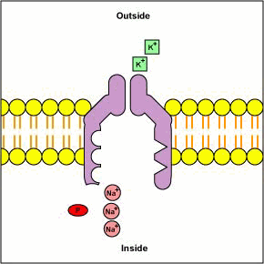
The Sodium Potassium Pump
Active transport takes energy
Easier encoding?
Faster reaction?
An Action potential happens when stimulation causes the pump to sort of stop, Na gets in, K goes out
Sort of reversed later

Slide 8
Biochemical Activity
Otto Loewi did a cool experiment in 1921
Simulated the vagus nerve is a frog’s heart
Slowed the heart down
Washed heart with solution, collected solution
Poured solution on a second heart
It slowed!!!!

Slide 9
Loewi and his frogs
Called the substance vagusstoff
Acetylcholine
Later stimulated heart rate, similar method
Ended up with a sped up heart
Epinephrine

Slide 10
The Synapse
Gap between the axon and the dendrite
Neurotransmitters are released across this gap
Sometimes, if all of the transmitter isn’t absorbed it is taken back up, this is known as reuptake

Slide 11
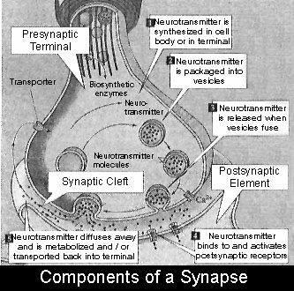
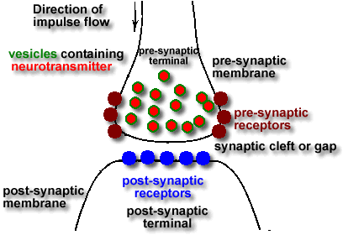
There is lots of variation in synapses
Some are inhibitory
Some are excitatory

Slide 12
More about synapses
Is the excitatory vs. inhibitory nature of a synapse due to shape?
Probably
GABA synapses are inhibitory, have less post synaptic thickening
Glutamate synapses have more thickening, more vesicles
There are 7 types of synapses

Slide 13
The Seven Steps in Neurotransmission
Synthesis
Storage
Release
Receptor interaction
Inactivation
Reuptake
Degradation

Slide 14
The Neurotransmitters
Basically, five conditions must be met before we call something a neurotransmitter
Present in terminal
Released on firing
Placing substance or organ emulates firing
Uptake for inactivation
Inactivation blocks stimulation

Slide 15
The Neurotransmitters
Acetylcholine (Ach)
Monoamines
Catecholamines
Norepinephrine (NE)
Epinephrine (E)
Dopamine (DA)
Indoleamine
Seretonin (5-Ht)
Others
Histamine (H)

Slide 16
More neurotransmitters
Amino Acids
Glutamate (universally excitatory)
GABA (universally inhibitory)
Glycine
Proline
Peptides
Substance P

Slide 17
Finally….
Morphine like substances
Endorphins
Enkephalins
Other peptides
Insulin
Prolactin
HGH
Vasopressin

Slide 18
Receptors
Transmitters bind to receptors
Sort of like a lock and a key
Binding site
Ion channel
One neuron (usually) has only one type of receptor
Great place for drug interaction

Slide 19
The Nervous system
Central Nervous system (CNS)
Brain, spinal column, cerebellum
Communication is neural
Peripheral Nervous system (PNS)
Nerves that make you move basically
Communication is neural
Autonomic nervous system

