Slide 1
Anti Psychotic Drugs
Biology/Psychology 3506

Slide 2
Introduction
Called that for a good reason
Diminish the symptoms of schizophrenia
Negative symptoms
Catatonia
withdrawal
Positive symptoms
Delusions
Paranoia

Slide 3
What is schizophrenia
Positive symptoms
Negative Symptoms
Thought disorder
Delusions of grandeur
Hallucinations
Paranoia
Withdrawal
Anhedonia
Avolition

Slide 4
Introduction
Neruoleptic is another term
‘clasping the neuron’
Also used to be called ‘Major Tranquillizers’
As compared to B & B
Not really an appropriate name, though they do have tranquillizing effects.

Slide 5
Introduction
Most useful classification is typical vs. atypical antipsychotics
Typical
Chloropromazine
Promazine
haliparidol
Atypical
Best known is clozapine

Slide 6
Introduction
Laborit tried antihistamines and the rest is history
Administered orally or by depot injection
Crosses barriers
Absorbed very slowly
Completely broken down by metabolism

Slide 7
Used for the following disorders
Schizoaffective disorder
bipolar disorder
Acute psychotic episodes
Treatment resistant depression
Schizophrenia

Slide 8
How do they work?
Block DA receptors
D2 especially
Direct relationship between effectiveness and D2 binding (r =1.00)
Also blocks Ach, 5Ht and H
Alters GABA, peptides
Blocks NE receptors, causes an increase in NE synthesis

Slide 9
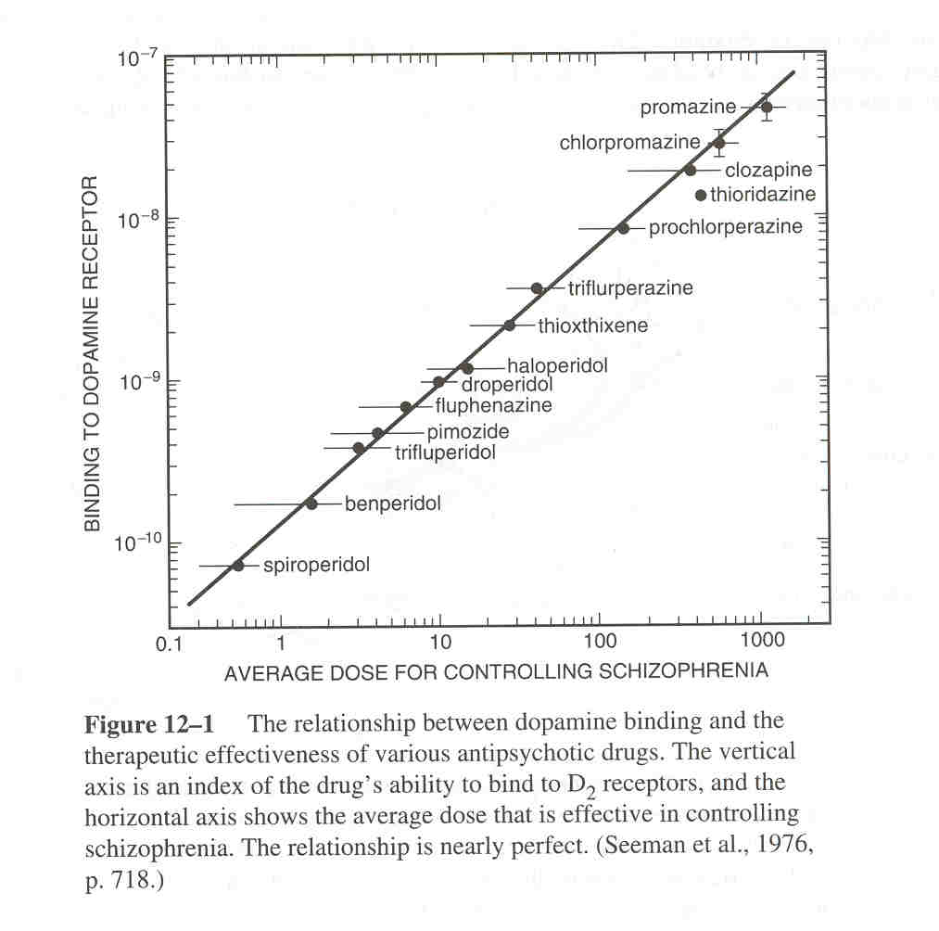

Slide 10
How do they work?
Key brain regions:
Mesolimbic dopamine system
That’s the reward system
nigrostriatal
Could be the atypicals have less effect in this area (more DA here)
Drugs that block cholinergic receptors stop Parkinsonian symptoms, so do atypicals.

Slide 11
Main effects
They stop the positive symptoms of schizophrenia
The atypicals have some effect on negative symptoms too.
More effective when symptoms are severe
Maintenance use not super effective
Must be used in conjunction with therapy

Slide 12
Side Effects
Parkinson’s symptoms are the nastiest side effect
Important to get the right drug in the right dose
Thermoregulation problems
Seizures
Liver failure
Exceedingly rare, but happens with atypicals
Probably only in middle eastern/Mediterranean people have the liver failure issue.

Slide 13
Side Effects
Basically slows all animals down, us included
Dissociative effects
Reduces sex drive
No withdrawal to speak of
No street value at all.

