Slide 1
Brain Organization, or, why everyone should have some neuroanatomy
Biology/Psychology 2606

Slide 2
Introduction
Anatomy vs. physiology
Brain is organized in, at best, a semi random pattern
Some of the names are confusing
Substantia negra
Zona inserta
Some make a teeny bit of sense
Hippocampus
amygdila

Slide 3
A few key terms
Anterior
Caudal
Dorsal
Frontal
Inferior
Lateral
Posterior
Rostral
Sagittal
Superior
Ventral
Medial

Slide 4
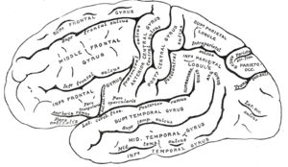
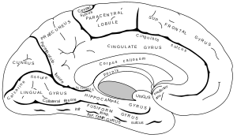

Slide 5
The outside has rich chocolate cooating
OK, it isn’t chocolate, but it is almost as tasty!
The meninges
Within which we find the CSF
Cerebrum
Cerebellum
Sulci and gyri

Slide 6
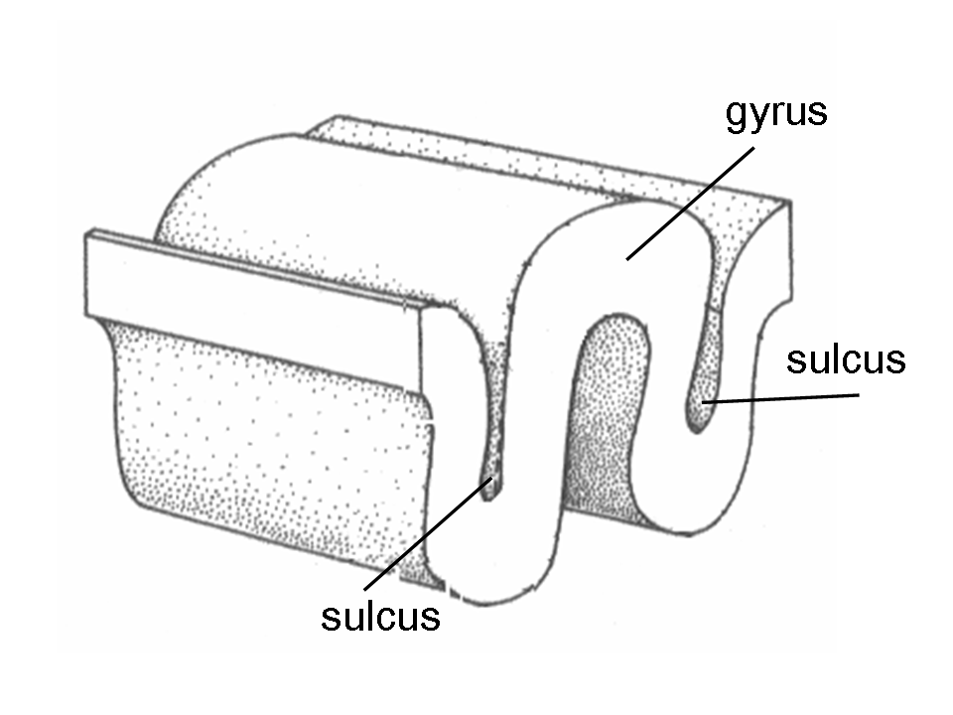

Slide 7
Brainstem
Cranial nerves
Lots of arteries and veins
Brain uses 25 percent of the oxygen in your system and about 75 percent of your glucose
So blood is pretty important
When blood supply is cut off to the brain you get a stroke

Slide 8
Some gross internal features
Ventricles
What do they do?
Good question
CSF production
White matter
Grey matter

Slide 9
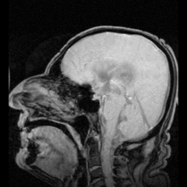
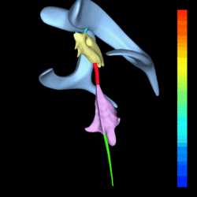
Notes:
Blue - Lateral ventricles
Cyan - Interventricular foramina (Monro)
Yellow - Third ventricle
Red - Cerebral aqueduct (Sylvius)
Purple - fourth ventricle
Green - continuous with the central canal

Slide 10
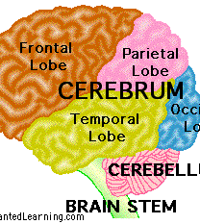
Internal Organization
Four lobes
Frontal
Parietal
Temporal
Occipital
In general they have function but remember this is in general

Slide 11
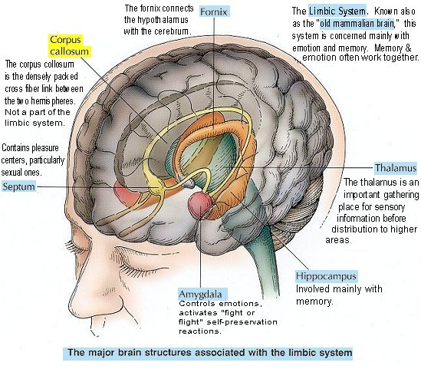
Some important Subcortical structures
Hippocampus
Amygdila
Thalamus
Hypothalamus
Nucleus accumbens
Medula

Slide 12
Brain is divided into two hemispheres
Connected via the corpus collosum
Not all animals have a cc
Many birds have only a small bundle of connections that allow their two hemispheres to communicate
Allows cool research to be donw
Nicky Clayton’s work on food storing birds

Slide 13
Neurons
Glial cells
Axons and dendrites
A whole bunch of neurons connected is called a tract or a nerve, depending on where it is
Nerve -> PNS
Tract -> CNS

Slide 14
CNS PNS et al
The division of the nervous system into say the CNS and the PNS is really about anatomy
Nothing wrong with this, but the distinction is not as much about physiology
Physiologically we can talk about the cranial nervous system and the spinal nervous system

Slide 15
Cranial stuff
Twelve sets of two
Control inputs and outputs from stuff in the head
The Brainstem gets inputs from the senses
Outputs to the rest of the body (so not the head in other words)
You can divide it into the hindbrain, midbrain and diencephalon

Slide 16
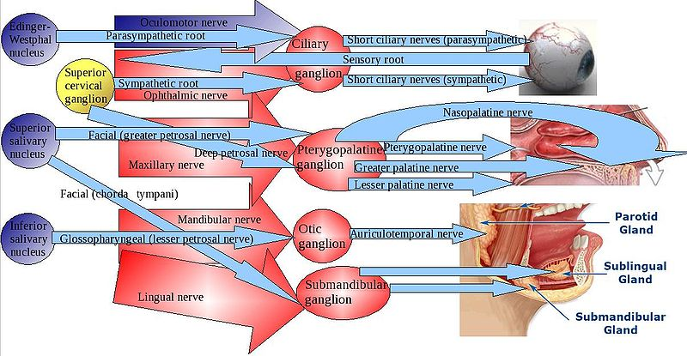
Cranial Nerve Schematic

Slide 17
Hindbrain
Fine movements
Balance
Cerebellum too
Key for fine movement
May be important in learning
Quick movements too
Reticular formation
Sleep, wakefulness
Connections to cortex, wake you up

Slide 18
midbrain
Tectum
Superior colliculus does vision
Inferior colliculus does audition
Just below the tectum is the tegmentum, also important in movement

Slide 19
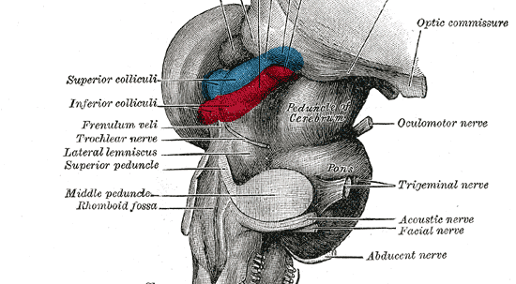
A closer look at the midbrain

Slide 20
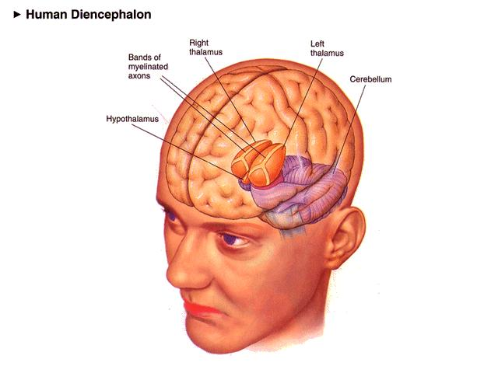
Diencephalon
Hypothalamus
Hunger
Thirst
Sex
thermoregulation
Thalamus
Sensory router

Slide 21
The Forebrain
This is where those lobes are
Collectively known as the Cortex
Limbic cortex or old cortex
Just below the neocortex
Basal ganglia
Very important in movement
Substantia negra is there
Parkinson’s

Slide 22
Limbic system
HP
Amygdala
Emotion?
Nucleus accumbens
Runs on dopamine
Olfactory bulb
Ours is itty bitty

Slide 23
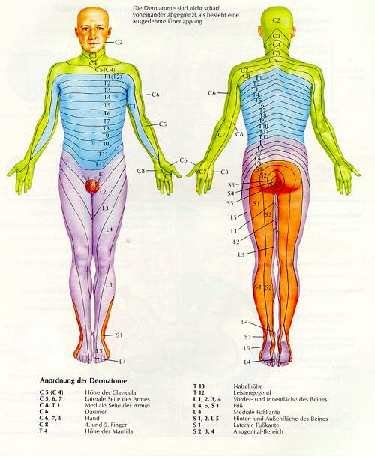
Spinal nervous system
Spinal column
Nerves running to and from the spinal column that control body and receive input
Dermatomes

Slide 24
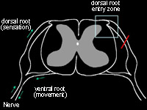
Inside the spinal column
Dorsal root
From sensory receptor
Ventral root
To movement
Bell-Megendie Law

Slide 25
Internal or Autonomic system
Sympathetic
Arousal
Parasympathetic
Cool down
A lot of what goes on in this system is hormonal

Slide 26
Principles of nervous system organization
Sequence is input -> integrate -> Output
Functional division between sensory and motor systems
Inputs and outputs are crossed
Symmetry and asymmetry
Excitation and inhibition
Multiple levels of function
Parallel and hierarchical (Hughlings Jackson)
Localized and distributed

Slide 27
