Slide 1
Development
Psychology/Biology 2606

Slide 2
Introduction
Brain development and behaviour development should go together
We can look at this in three ways
Structural development and behavioural changes
Switch it around, look at behaviour and infer neural mechanisms
Look at factors that affect both

Slide 3
Some Issues
Preformation
Embryos of different species are not that dissimilar
All vertebrates have a forebrain, brainstem and neural tube as embryos

Slide 4
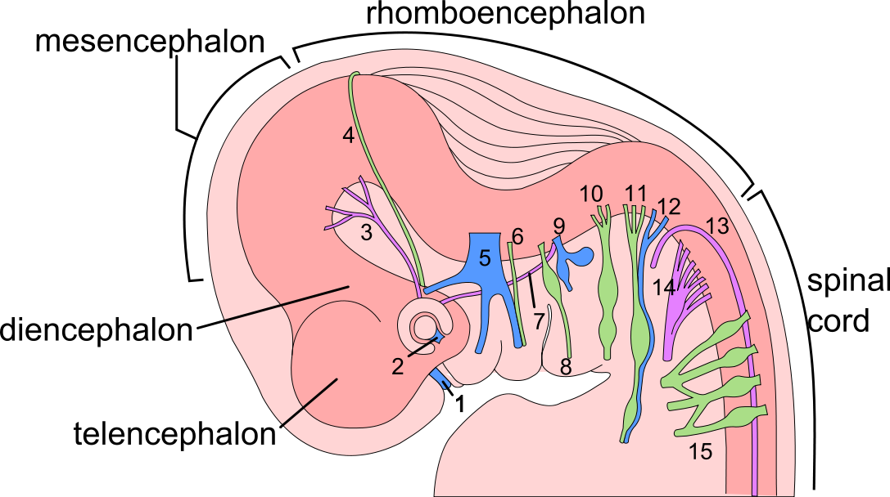
Notes:
1 month, maybe 5 weeks
a couple of mm

Slide 5
Gross development
When a Mommy and a Daddy really like each other...
Primitive body at 15 days
Neural plate at about 3 weeks
Plate curls up, forms the neural groove, this becomes the neural tube
By 49 days pretty human like
Notes:
about 5 or 6 weeks in neural tube

Slide 6
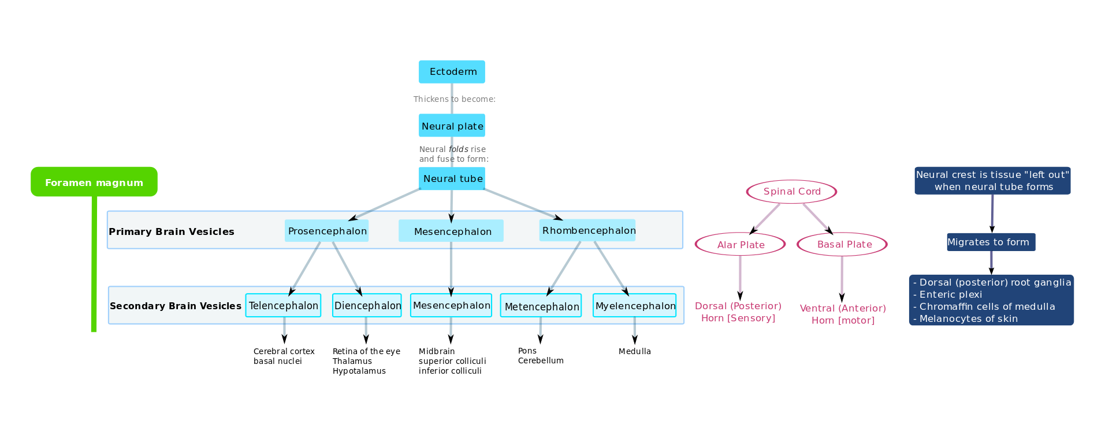
Generally

Slide 7
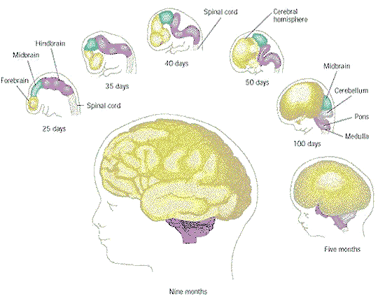

Slide 8
Peepees and weewees
Sexual differentiation is going on throughout this process too
This is important because testosterone basically masculinizes the fetus
Not just the genitals, but also the brain
Notes:
Talk about sex differences to begin with, what if you could take girls and give them T? 5h Testotsterone still masculaizes brain
5 alpha reductase syndrome
CAH too much epinephrine, masculinizing female brains

Slide 9
Stem Cells
Neural stem cells line the neural tube
These divide quickly
Unlike adult stem cells, these guys divide and divide again, like well, like 'normal' (non neural) cells
Adult stem cells divide, but then one daughter cell dies!
Stem cells become neuroblasts or glioblasts

Slide 10
Differentiation
How the heck does a cell know what sort of cell it is supposed to become?
Genes turned on and off
Chemical environment
EGF -> progenitor cells
bFGF -> neuroblasts
At peak growth rates we are making 250 000 cells a MINUTE!
Notes:
Epidermal Growth Factor.
Basic firbroblast growth factor

Slide 11
Stages in brain development
Cell birth
Migration
Differentiation
Maturation
Synaptogenesis
Cell death
mylenogenesis

Slide 12
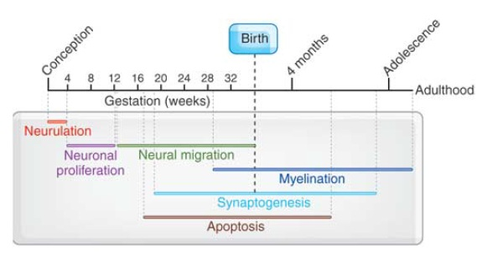
Human Brain Development Timeline

Slide 13
Generation, migration and differentiation
Much easier to fix trauma if early on
Migration takes about oh 6 to 7 weeks
Then differentiation kicks in
Cells formed in a particular region differentiate into different types of neurons
Follow the radial glial road (very cool)
Layers of cortex develop from the inside out, as you would expect

Slide 14
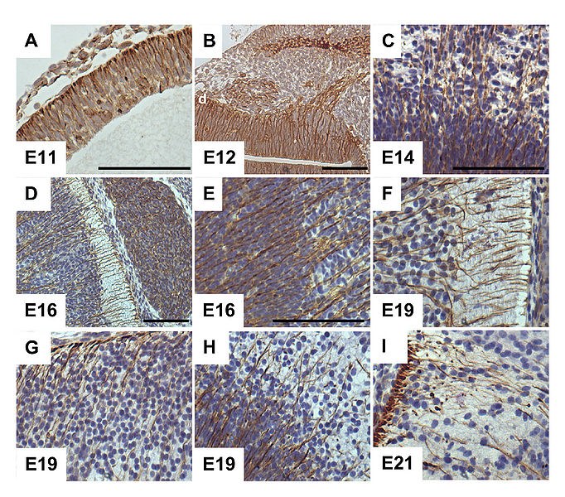

Slide 16
Maturation
Dendritic branching starts
Dendrites grow slowly, whereas axons grow quite quickly
Basically axonic growth is guided by various molecules, and concentrations of these chemicals tell the axon where to go

Slide 17
Synapses
1 00 000 000 000 000 synapses....
OK so that is a lot
Basically, couldn't just be programmed
Must be again chemical messages saying go here or there

Slide 18
Cell Death
Neural Darwinism
Use it or lose it basically
If a cell does not get NGF it dies
So if many cells are competing for one synapse, the one that gets the NGF wins, others die
Brains are expensive, they should be efficient

Slide 19
Behaviour and Brain
Motor stuff
Flex joints at birth
One month, orient hand
8 months or so, pincer grip
Could be to do with formation of myelin

Slide 20
Language
At birth, babies cry, basically hunger and discomfort
Cooing and babbling
Intonation changes
12 month old often has a vocabulary of oh 10 words or more
2 year old may know 300 words
3 year old as many as 1000

Slide 21
4 year old, 1500, uses sentences, understands number
By 6 a kid can understand tens of thousands of words, uses maybe 2000 usually
An adult may have a vocabulary of 50 000!
Could be correlated with dendritic development in Broca's area

Slide 22
Cognitive development and the brain
Kinda tough to correlate them
You can look at Piagetian (sp?) stages, and the data are suggestive
There are growth spurts that happen roughly in time with these.
But, beyond that there may not be much

Slide 23
Environmental effects
Enriched rats
More cortex
Better at mazes
Plasticity decreases with age
Basically experience fine tunes connections
Critical periods and sensitive periods

Slide 24
Bad stuff
Romanian orphans
If adopted early, they are pretty much ok
Later, well, the later they were adopted, the poorer their health in general, and their IQ scores were well below average
Crack babies
More the result of the lifestyle than the coke

Slide 25
Conclusions
Development has a tendency (developmental canalization) to go ok even if things are suboptimal.
Development continues into early adulthood (neurally) but it’s nothing like what’s going on in a baby or a fetus.
Correlating behaviour to neural development is not super easy.

