Slide 1
Language and Your Brain
Biology/Psychology 2606

Slide 2
Introduction
Language is uniquely human
Semantic and syntactic
There is communication in other species, but nothing remotely as complex as human language

Slide 3
Geschwind-Lichteim-Wernicke Model
Thanks for the easy to remember name….
Throughout much of the 20th Century this was the go to idea about language processing in the brain
For receiving language, info goes from auditory pathways to Area 41 (primary auditory cortex) then on to Wernicke’s area where meaning of words is obtained
For producing language, Wernicke’s to Broca’s via the arcuate fasciculus

Slide 4
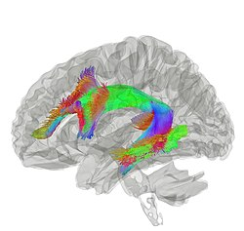
Notes:
arcuate fasciculus means ‘curved body’ in Latin

Slide 5
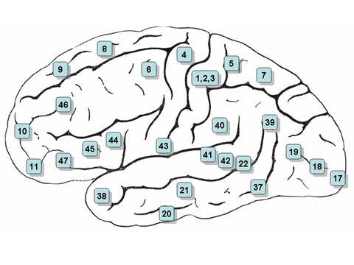
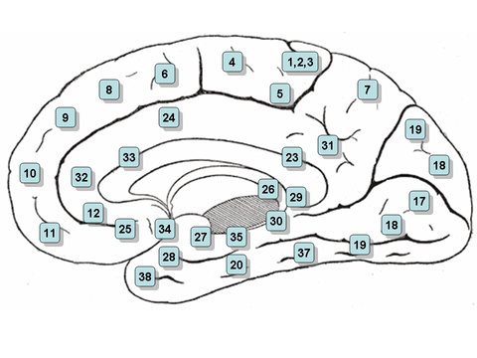
Brodmann brain map

Slide 6
Geschwind-Lichteim-Wernicke Model
Information now in Broca’s Area
Morphemes are assembled
Broca’s Area holds a representation of how to make a word
Info sent say to facial muscles, or to hands (for writing or signing).

Slide 7
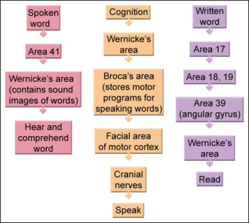
An elegant and simple model
That’s wrong…..

Slide 8
Contemporary Thinking
Two streams that connect the auditory cortex to frontal lobe
Auditory Dorsal Stream (ADS)
Sound localization, also in other primates, the where pathway
Auditory Ventral Stream (AVS)
Sound recognition, the what pathway

Slide 9
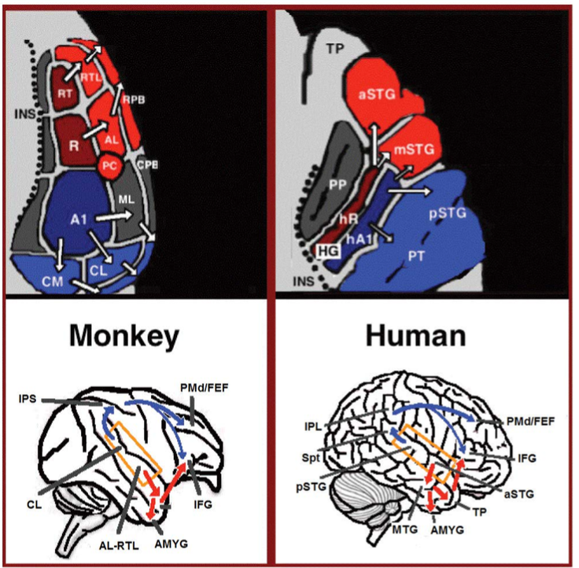

Slide 10
AVS - The What Pathway
Recognizing ‘auditory objects’
Sequences of tones for example
Short units of speech, like phonemes
MTG-TP is the ‘semantic lexicon’
MTG-TP is important is sentence comprehension

Slide 11
ADS - The Where System
Auditory cortex to parietal lobe
Speech production
Lip reading
Speech repetition
Phonological loop

Slide 12
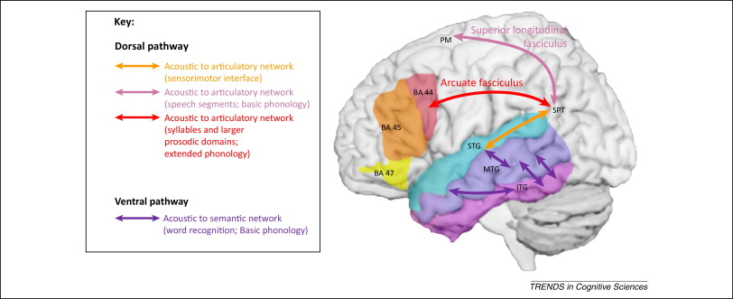

Slide 13
Language Evolution
We have to understand cause and function to truly understand behaviour
How did human language evolve?
OK, that’s a good question
New languages can spring up out of nowhere though, Nicaraguan Sign Language for example
We are probably wired for language

Slide 14
Language Evolution
The Mother tongue hypothesis and kin selection
The further you get from Africa, the fewer phonemes you have in a language
Less genetic diversity as migration out of Africa happened, so fewer phonemes
Wait, language has a genetic basis?
Wait for the next slide…..
Language probably showed up between 100 000 and 50 000 years ago
Coincides with behavioural modernity

Slide 15
Genes and Language
The KE Family in the UK
about 1/3 of the kids have developmental verbal dyspraxia
Less motor neuron activity in areas that control the tongue and face
Have a mutation in FOXP2 gene on chromosome 7
FOXP2 is important in many animals’ communication

Slide 16
Conclusions
Language is uniquely human
Animal models are hard here, though not impossible
Like any other characteristic, language evolved

